Slide 1
MINI PROJECT [AED334] AUTOMATED SELF ISOLATING WATER LEVEL CONTROLLER GROUP NO:-03 ANJALI H NAIR(CHN19AE008) MOHAMMED SHAHEER V K(CHN19AE015) ANAGHA P(LCHN19AE021) ARATHY C S(LCHN19AE022)
GUIDE NAME :- Ms.KARTHIKA KRISHNA
DEPT OF ELECTRONICS AND INSTUMENTATION

Slide 2
OBJECTIVES
To create the most cost-effective and reliable water level controller using as less resource as possible.
To develop a mechanism to automatically shut down the pump when the water tank is filled completely and to turn on the pump when water level is too low.
To compare the controller with the conventional controllers in market and find the advantages

Slide 3
LITERATURE SURVEY
SL NO | REFERENCE | STUDIES / FINDINGS
1 | Design and Development of Automatic Water Flow Meter(International Journal of Computer Science, Engineering and Applications (IJCSEA) Vol.3, No.3, June 2013) | This research paper by Ria Sood, Manjit Kaur, Hemant Lenka emphases on the need of water level controller in irrigation in agriculture.

Slide 4
LITERATURE REVIEW
SL NO | REFERENCE | STUDIES/FINDINGS
2 | Automatic Water Level Controller with Short Messaging Service (SMS) Notification (International Journal of Scientific and Research Publications, Volume 4, Issue 9, September 2014) | This research paper by Sanam Pudasaini, Anuj Pathak, Sukirti Dhakal, Milan Paudel presents a system of an automatic water level controller with SMS notification. SMS notification was added to automatic controller system so that water can be managed by user during load shedding

Slide 5
LITERATURE REVIEW
SL NO | REFERENCE | STUDIES/FINDINGS
3 | Automatic Water Level Control System (International Journal of Science and Research (IJSR) | This research paper by Asaad Ahmed Mohammed, Ahmed Eltaieb , Zhang Jian Min involves designing and development of automatic water level control system had exposed to the better way of software and hardware architecture that blends together for the interfacing purposes. The system employs the use of advance sensing technology to detect the water level. It uses Arduino and uses relay to control motor.

Slide 6
FEATURES
Easy installation
Low maintenance
Compact and elegant design
Fully automatic
Saves water, motor and energy
Increases pump life.
Avoids seepage of water from roofs & walls due to overflowing tanks.

Slide 7
BLOCK DIAGRAM
POWER SUPPLY
SENSING ELEMENT
IC 555
TRANSISTOR BC 547
RELAY
AC PUMP
WATER TANK

Slide 8
DESCRIPTION
POWER SUPPLY
230v AC is given to the input of step-down transformer
This is converted to 12 V and is supplied to the circuit

Slide 9
DESCRIPTION
SENSING ELEMENT
These are metallic contacts which conduct electricity when the space between them is bridged by water
For our project, one contact at the bottom part and one contact at the upper part of the tank form the indicator for low level and overflow of water respectively.

Slide 10
DESCRIPTION
IC 555 IN MONOSTABLE MODE
The timer will be in its stable state (Output LOW) until it is triggered.
When the capacitor voltage is lesser than 2/3 Vcc, the output becomes HIGH. When the capacitor voltage will become greater than 2/3 Vcc, the output becomes LOW.
Turns on/off relay based on water level

Slide 11
DESCRIPTON
TRANSISTOR
When the water touches the metal contact in which base of each transistor is connected, a small current flows and turns on the transistor.
When a transistor turns on, LED connected to it glows. Thus LEDs will be turned on depending up on the level of water.
RELAY
Acts as a switch which turns on or off the pump by cutting off the power supply to water pump

Slide 12
DESCRIPTION
AC PUMP
Pumps water into the tank
Transforms electrical to mechanical energy

Slide 13
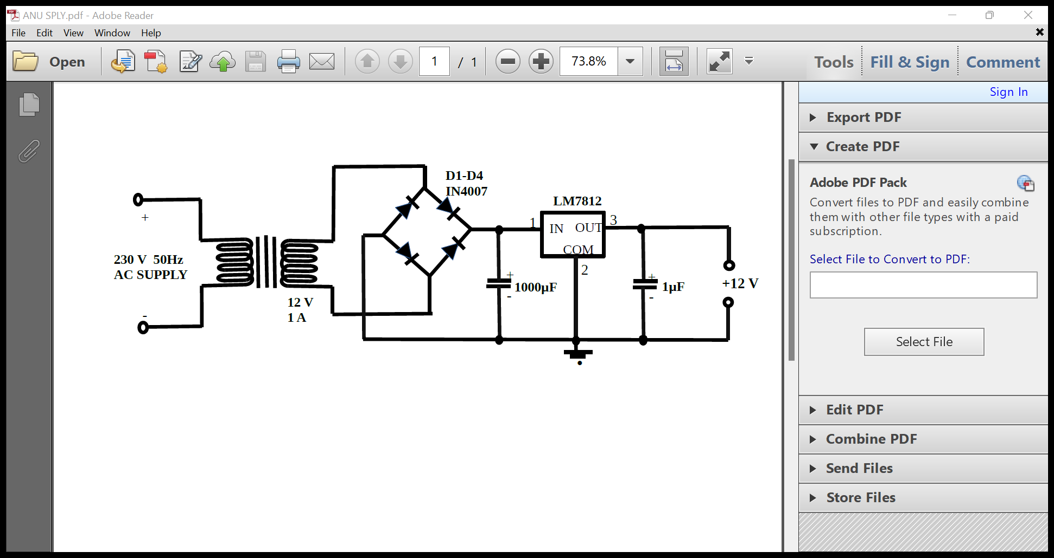
POWER SUPPLY DIAGRAM
Tx=Primary 230 V , Secondary 12 V ,1 A
Stepdown Transformer

Slide 14
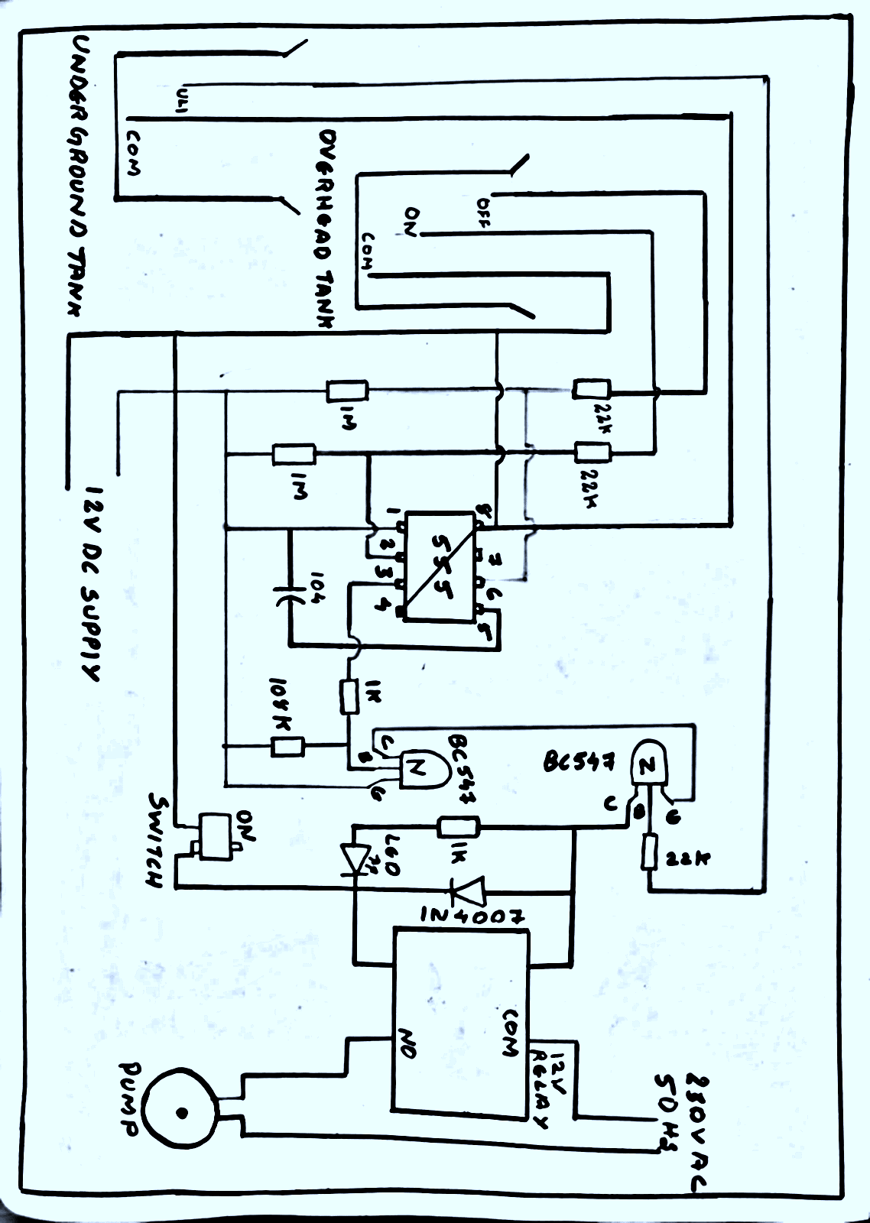
CIRCUIT DIAGRAM

Slide 15
DESCRIPTION
We have developed water level controller circuit using NE555 Timer .The circuit uses transistor, NE555 timer IC, a relay and few passive components.
The circuit is completely automatic which starts the pump motor when the water level in the over head tank goes below a preset level
switches OFF the pump when the water level in the over head tank goes above the full level

Slide 16
WORKING
In NE555 Timer, acts as monostable multivibrator, the output will increase when the power of the second pin (trigger pin) is not more than 1/3 Vcc.
The output of 555 is connected on a BC547 transistor, activating the transmission coil and water pump will be turned on.

Slide 17
WORKING
When water level in storage tank is low, output of 555 become high, which turns on relay which in turn , on the pump.
When water level reaches maximum, output of 555 becomes low and turns off the relay and thus pump is turned off.

Slide 18
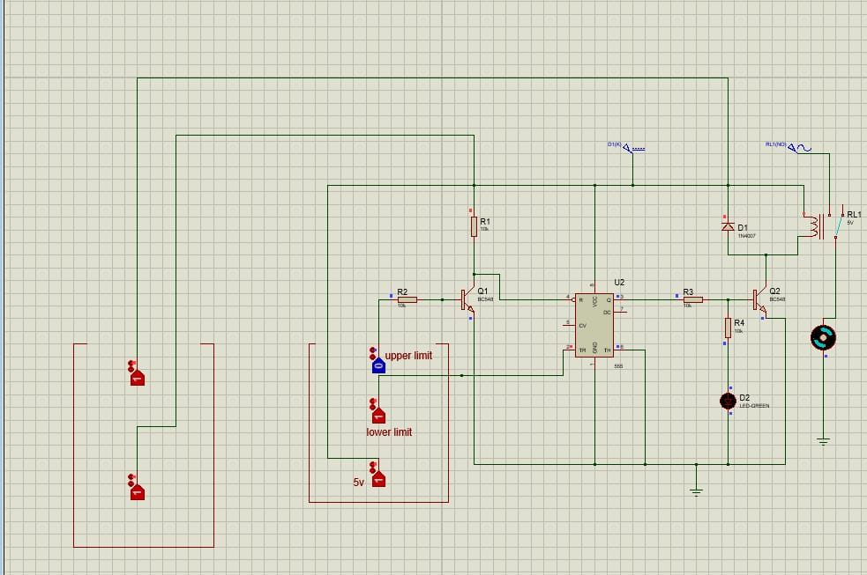
SIMULATION

Slide 19
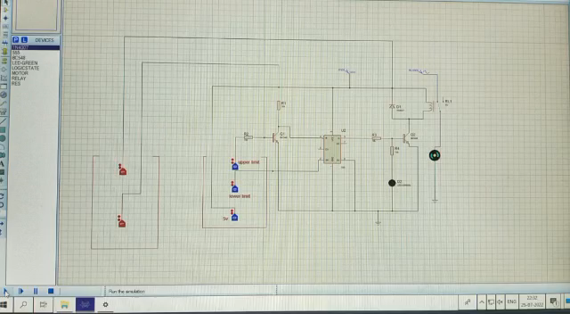
SIMULATION

Slide 20
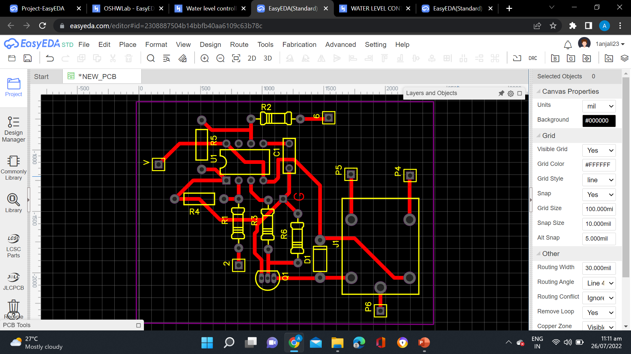
PCB LAYOUT

Slide 21
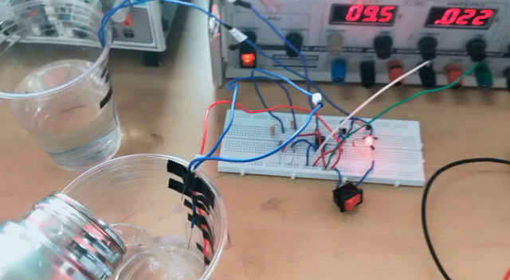
HARDWARE RESULT

Slide 22
COST ESTIMATION
COMPONENT NAME | KEY SPECIFICATION | QUANTITY | UNIT PRICE | TOTAL PRICE
TRANSFORMER | 12 V, 1 A | 1 | 200 | 200
DIODE | 1 A, 1000 V | 5 | 10 | 50
CAPACITOR | 100 nF, 1000 mF, 1mF | 3 | 10 | 30
LM7812 | 2.2 A, 45 V | 1 | 15 | 15
555 TIMER | 200 mA, 16 V | 1 | 20 | 20
TRANSISTOR | 100 mA , 45 V | 2 | 15 | 30
LED | 1.5 V,5 mm ,Red | 1 | 15 | 15

Slide 23
COST ESTIMATION
COMPONENT NAME | KEY SPECIFICATION | QUANTITY | UNIT PRICE | TOTAL PRICE
RESISTOR | 1K-0.25 W,22K -0.25 W,180K -0.25 W, 1 M-0.25 W | 8 | 5 | 40
RELAY | SPDT , 12 V | 1 | 30 | 30
WATER PUMP | 5 W, 230V | 1 | 30 | 30
SWITCH | SPDT(SLIDE TYPE) | 1 | 30 | 30
MISCELLANEOUS |  | -- |  | 400
 | TOTAL |  |  | 1100

Slide 24
CURRENT WORK STATUS
The power supply is designed and implemented on PCB.
The control system using IC 555 has been designed and output is obtained.
The overall circuit is designed and implemented on PCB, output is taken.
Simulation is completed on proteus

Slide 25
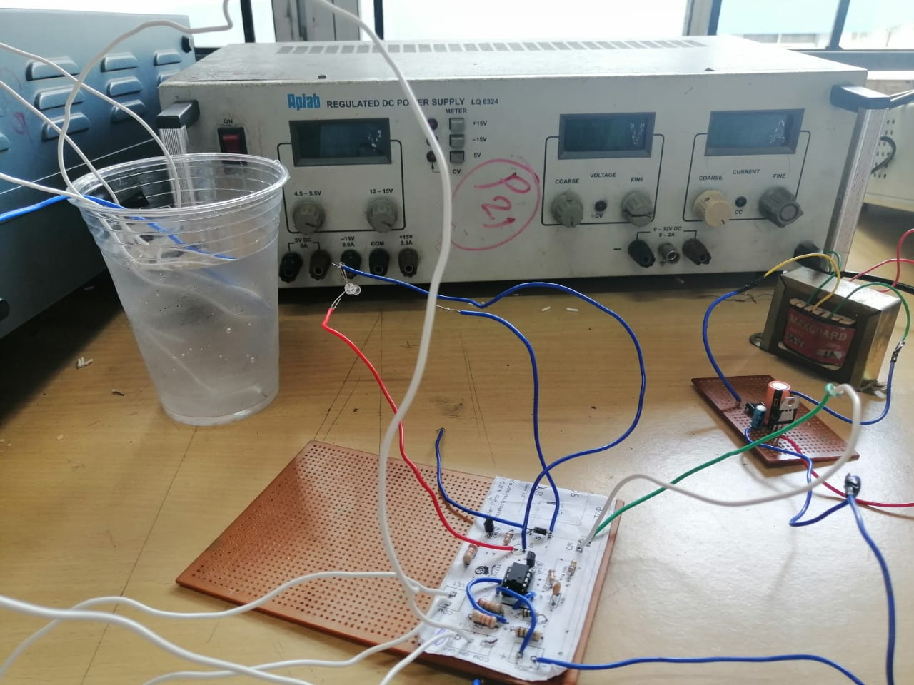
WORK PROGRESS

Slide 26
GANTT CHART

Slide 27
CONCLUSION
In these days, when Earth's reserve of consumable water is decreasing every moment, every drop has its value. Water level controller is a simple yet effective way to prevent wastage of water
Hence we conclude that-
This system is very beneficial in rural as well as urban areas.
It helps in the efficient utilization of available water sources.
If used on a large scale, it can provide a major contribution in the conservation of water for us and the future generations.

